Slide 1

Welcome
Presentation of The Learning Triangle

Slide 2
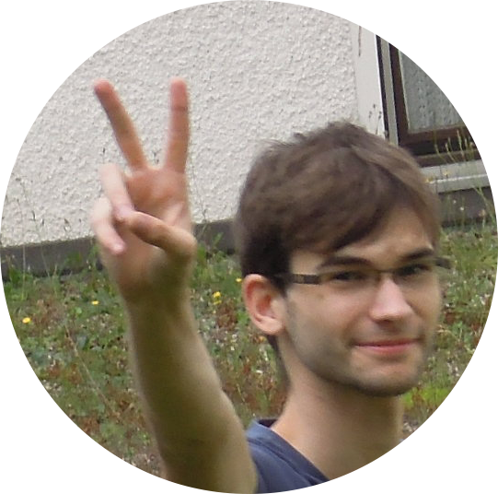
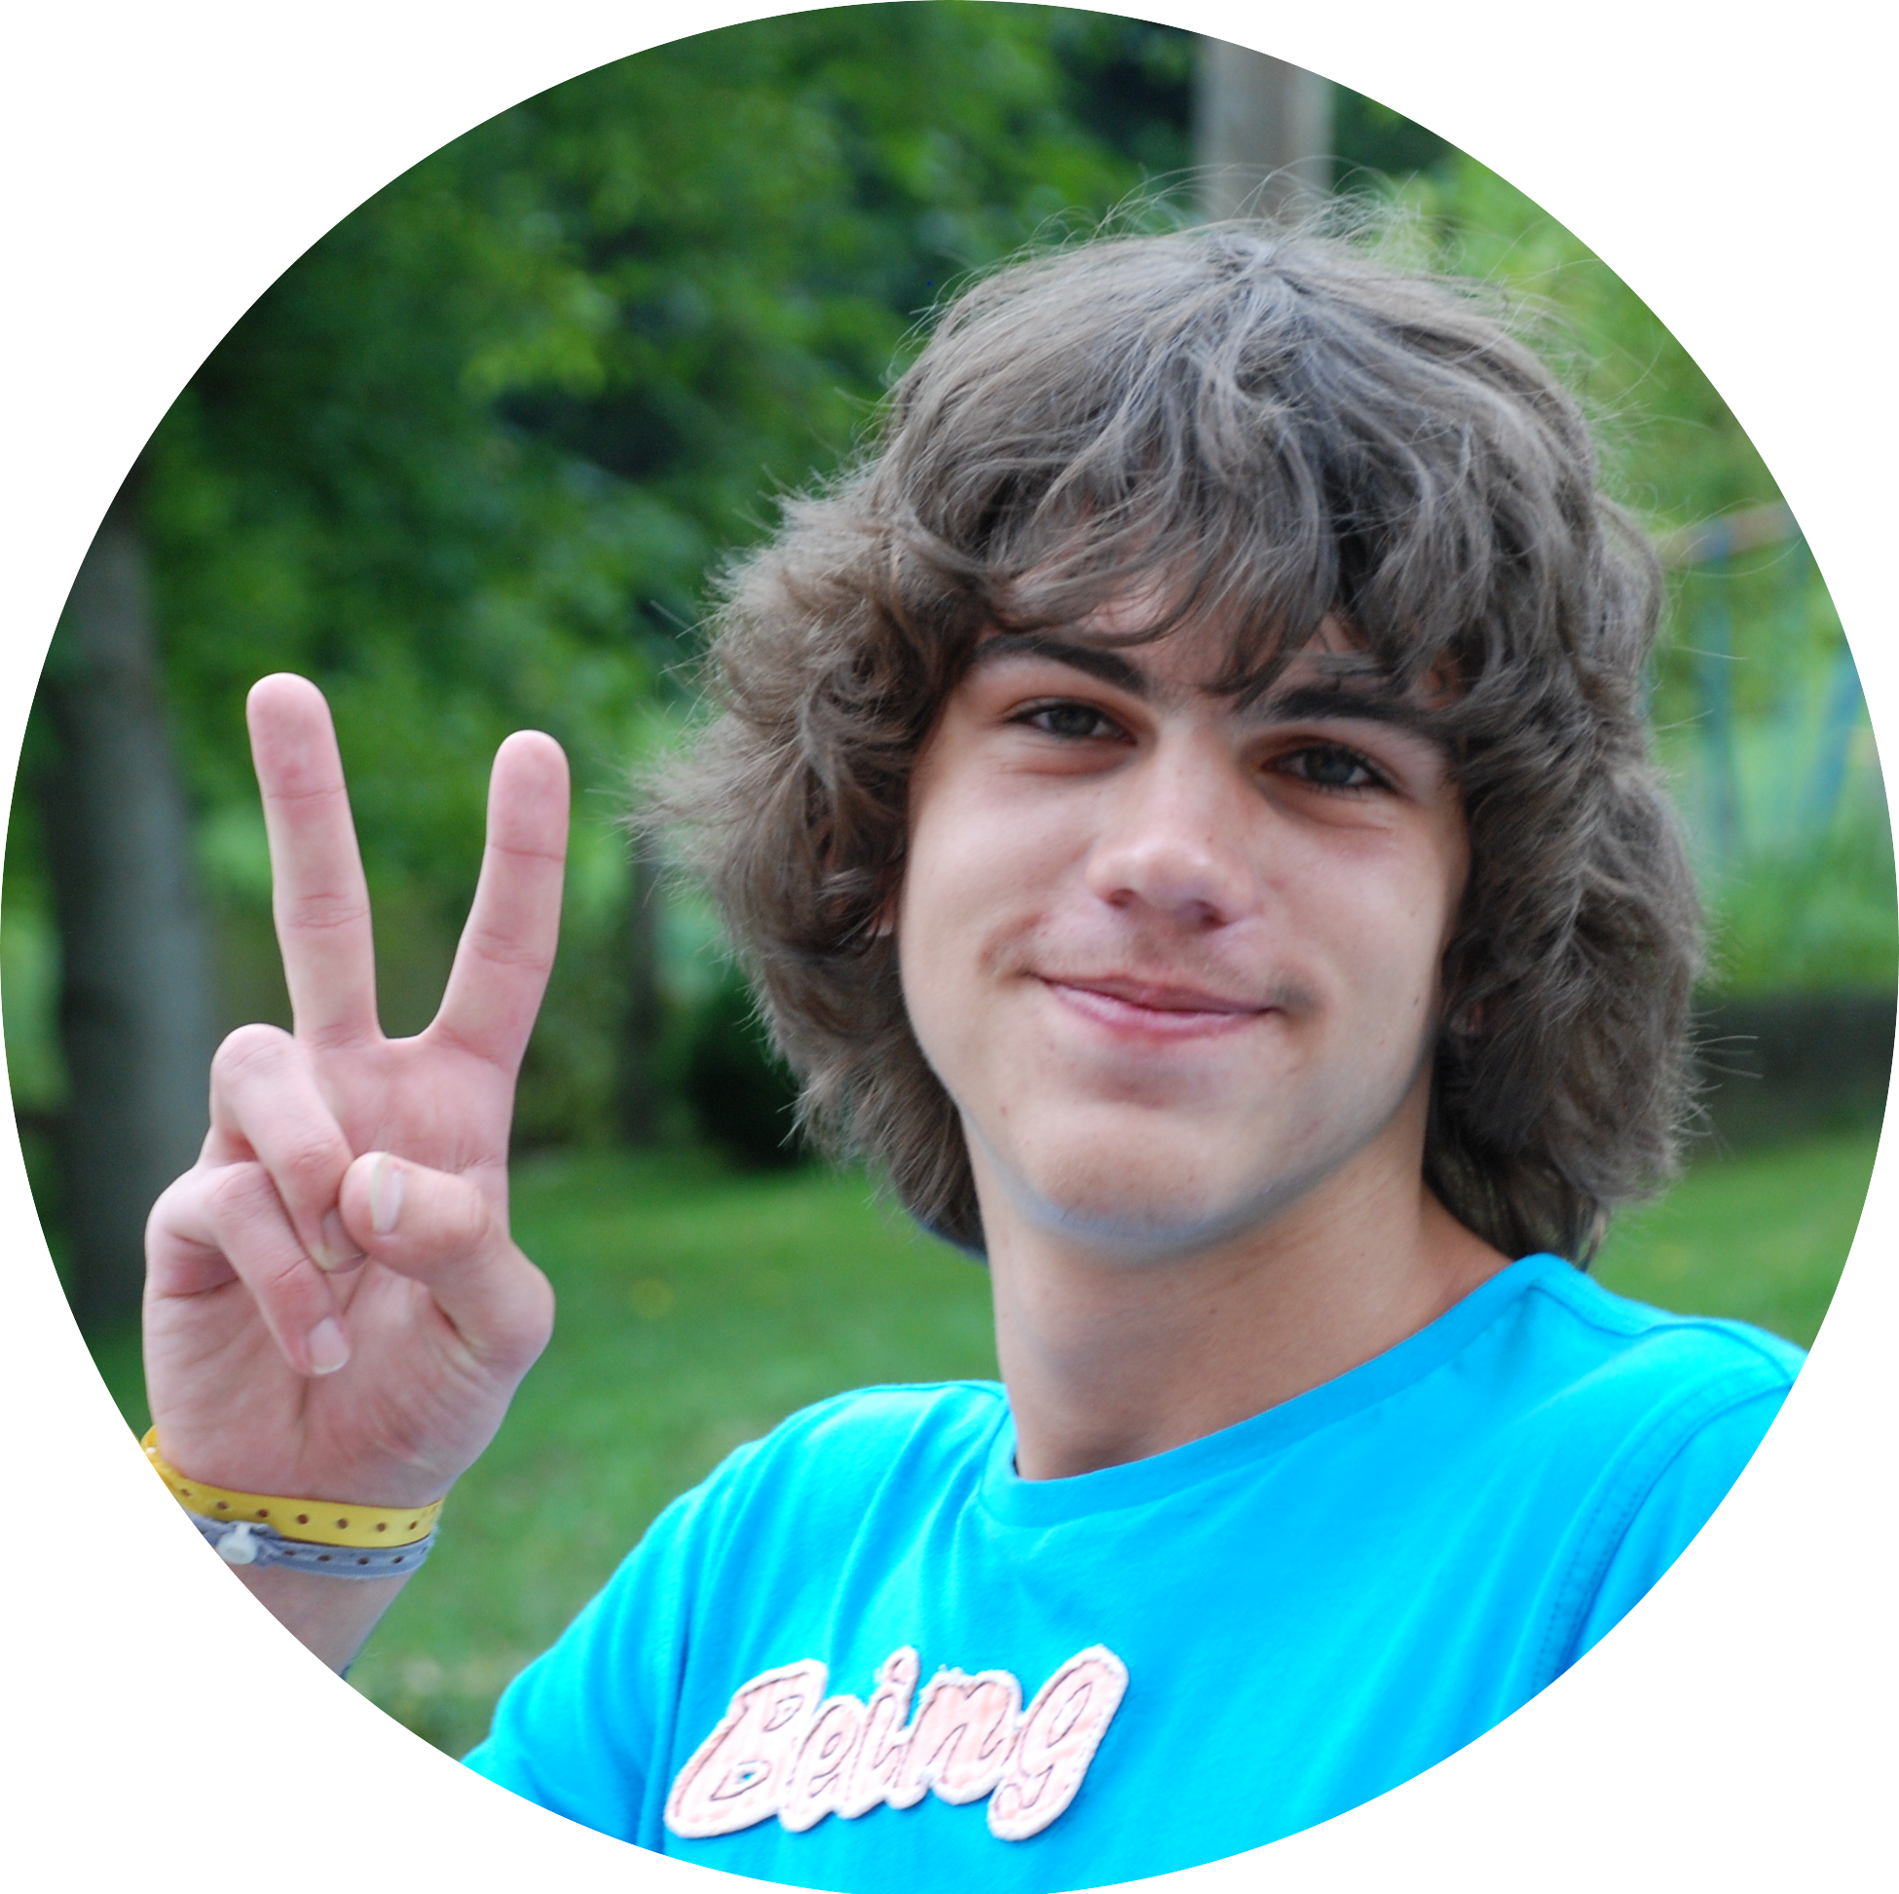
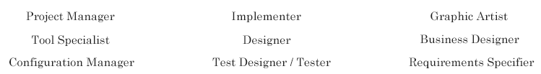
Team
Steven Kovacs Marco Müller
We are using the Rational Unified Process for our roles

Slide 3
Our vision
create a game with no user-interaction at all
look how an artificial intelligence lives in an artificial world with clearly defined rules
just an algorithm, no player

Slide 4
Purpose of this project
non-profit
research in an upcoming area of computer science
do something we had never done before

Slide 5
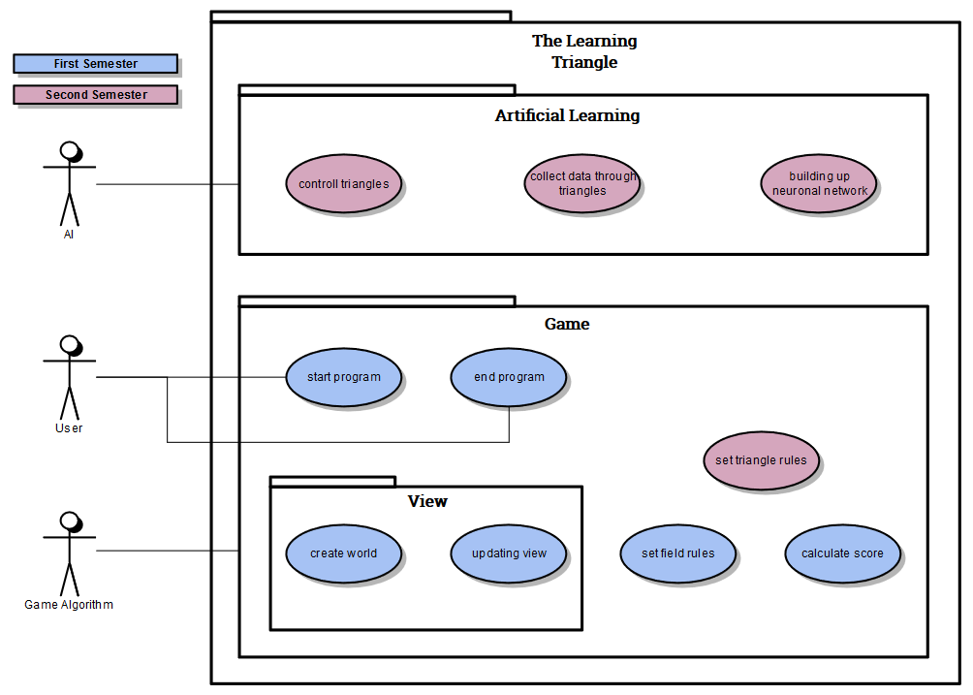
Use Cases & Scope
project parts splitted into smaller parts → Use Cases
First Sem. : game rules
Second Sem. : Neuronal Network

Slide 6
Project Management
How to document the specifications and Use Cases?
Software Architecture Document and Software Requirements Specification
each Use Case <-> Use Case Document

Slide 7
The way we develop
We followed the idea of an agile project
→ you have to welcome a change while you are working on your project
more contact with customer to follow his wishes
→ don’t develop over some months just to realize at the end that the customer wanted a program completely different

Slide 8
Scrumming
realising an agile project needs a good overview over state of the project and remaining time → we use JIRA
JIRA is a
Platform to create and edit tasks
Associate tasks with people
Log worktime
Estimate operating expenses

Slide 9
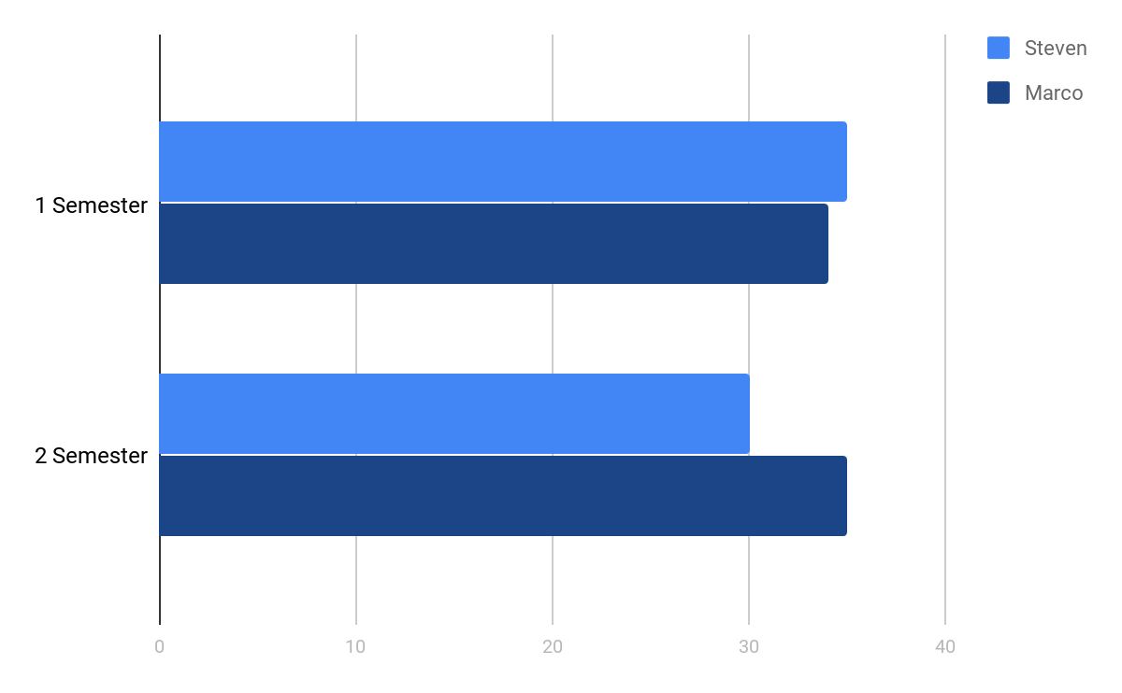
Time spend

Slide 10
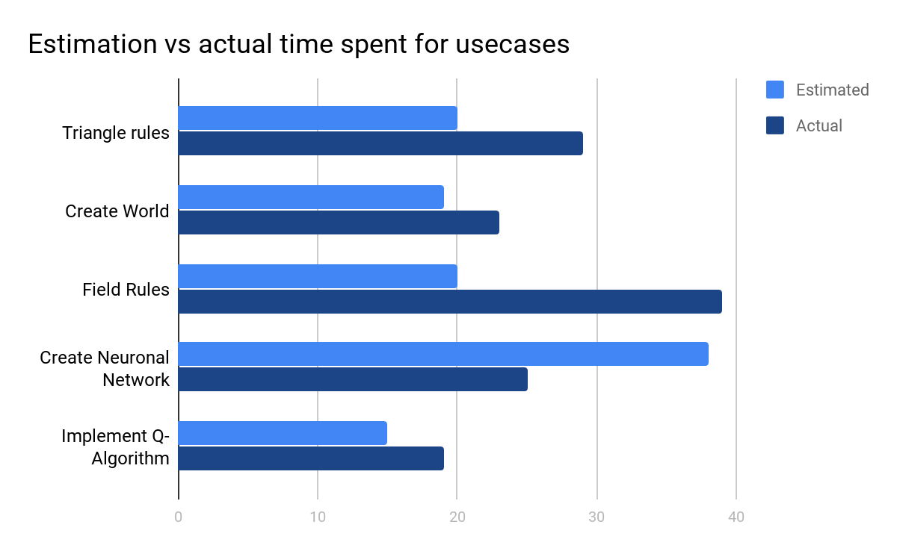
Estimation vs real time spent

Slide 11
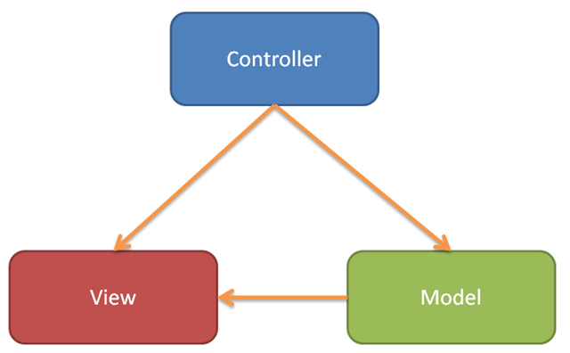
Patterns
we use the MVC pattern in our project
Model contains the data
Controller contains the algorithms
View contains the methods for showing the UI

Slide 12
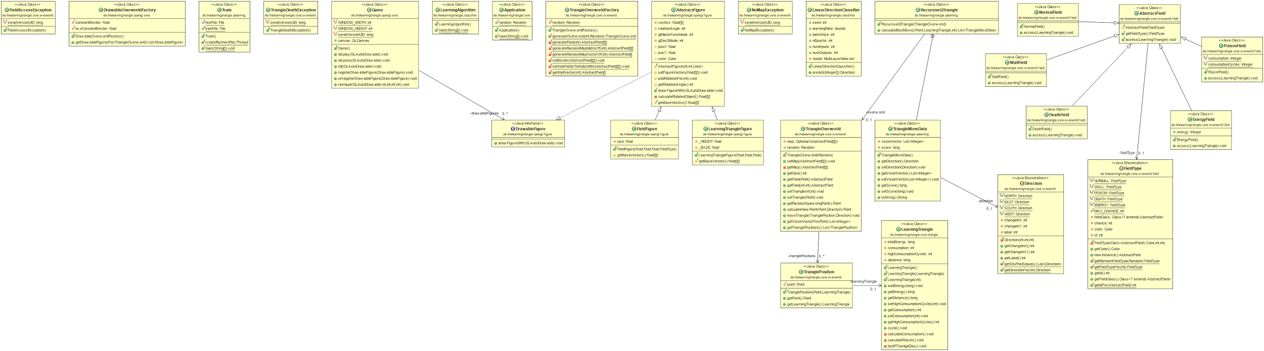
Class Diagram

Slide 13
Application testing
since we barely have any overview we decided to just use JUnit for unit-testing
We can run all tests within one to two clicks

Slide 14
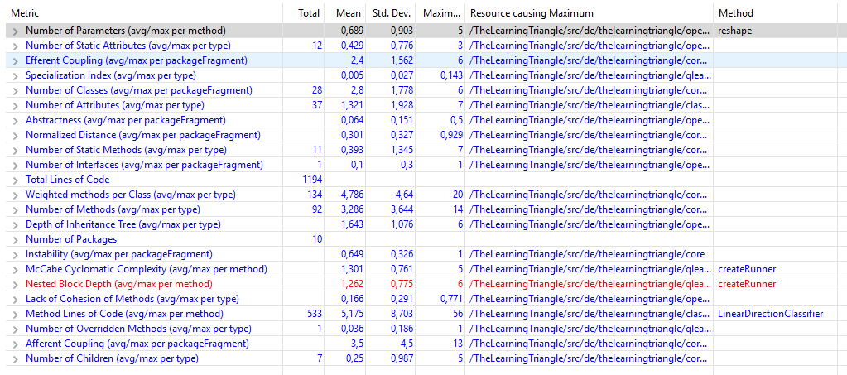
Metrics
Eclipse-Addon Metrics 1.3.6
→ rates the results
→ shows you the critical points of your project

Slide 15
Risk Management
identified | prob of occurrence | damage | mitigation strategy | person in charge | risk factor
neuronal network doesnt behave as expected | 25,00% | 100,00% | include more machine learning frameworks for usage but tensorflow | Steven & Marco | 25%
not enough time to get engaged with machine learning | 10,00% | 100,00% | start early enough with reading documentations | Steven & Marco | 10%
TDD takes to much time and work | 15,00% | 30,00% | priotize working solutions over tested but unworking code | Marco | 5%
untested funcionality doesnt work on first try | 50,00% | 5,00% | recode funtionality | Steven & Marco | 3%
project architecture becomes unclear | 10,00% | 15,00% | refactoring, could influence deadlines | Marco | 2%
private computer/server isn't strong enough to train the network | 5,00% | 15,00% | use computer from DHBW | Steven | 1%

Slide 16
Life cycle management
We don’t use life cycle management because
We don’t have a product to use, just to research on
We don’t have a web-platform to deploy our project on, it’s mostly a console application

Slide 17
The technology we are using
OpenGL ( JOGL-Framework )
JUnit-Framework
Deeplearning4J
GitHub
Jira

Slide 18
What does machine learning mean?
abstract and classify situations
learn specific tasks
automate complex behavior

Slide 19
What is The Learning Triangle?
a neuronal network
approach brute force problem solving
artificial creature living in an artificial environment

Slide 20
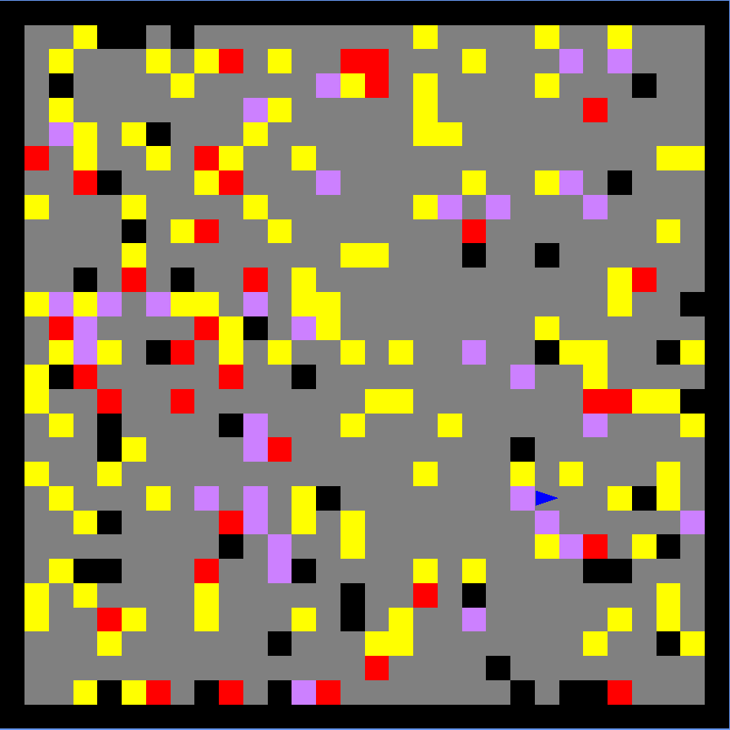
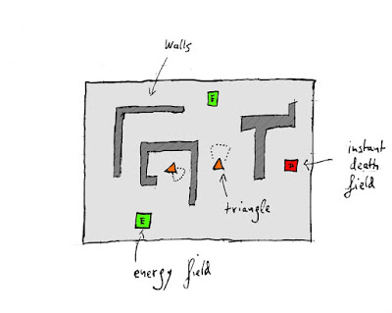
Concept to implementation

Slide 21
How do we learn?
We implemented an Q-Algorithm
Reward function
Very expensive calculation
O(4^n)
Write the first 5 results in a csv-file

Slide 22
How does such a csv-file look like?
One line is one set of data
Lines are separated by “\n”
Fields are separated by “,”
First field is the “label” (the route the q-algorithm would take)
Other 36 fields are the vision

Slide 23
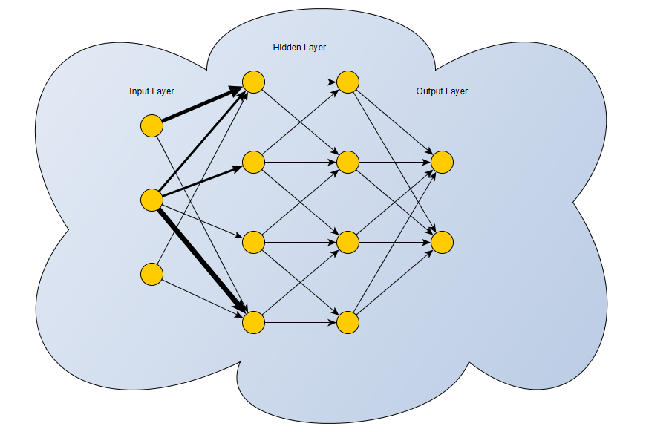
How does our neuronal network looks like?

Slide 24
Demo of our project

